Slide 1


200021241 Md. Rahib-Bin-Hossain
200021242 Md. Muhidur Rahman
200021244 Shafin Ibnul Mohasin
200021247 K.M. Sirazul Monir
EEE 4602
Signals And Systems Lab
Project:
Real-Time Moving Object Detection and
Background Removal in Video Streams using MATLAB

Slide 2
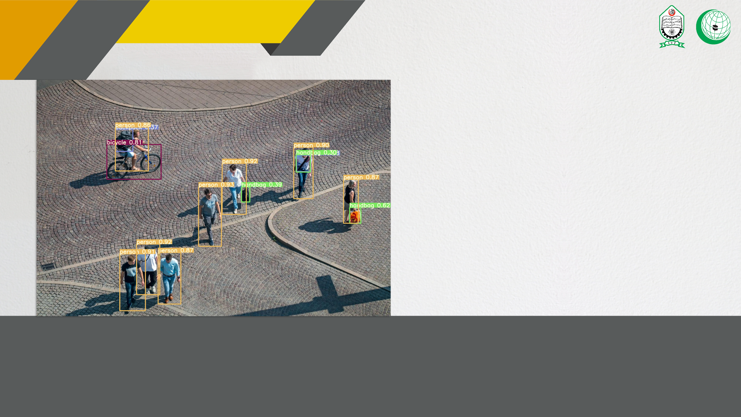
INTRODUCTION
Real-Time Moving Object Detection
and Background Removal in Video Streams
using MATLAB
Moving object detection employs three main methods: frame subtraction, optical flow, and background subtraction.
Frame subtraction compares consecutive images, though it struggles with accurate object outlining. Optical flow
calculates image flow fields, providing detailed movement information but with computational intensity and
noise issues. Background subtraction compares current images with a background reference, offering detailed
object information if the background is known, but it's sensitive to environmental changes and noise,
making dynamic background modeling and threshold selection crucial for static camera conditions.

Slide 3

INTRODUCTION
ALGORITHM
Extract frames and its
height, and width.
y
Employ MSE to compare
blocks between frames.
Use MATLAB to
read the video.
Segment frames
into 16x16 blocks.
Identify moving objects if <50% match, retain original values.
Consider blocks matched if MSE < 15%.
Obtain output video with only moving objects, eliminating background.
Declare blocks part of background if >50% match, making them white.

Slide 4

INTRODUCTION
Key Image processing techniques used:
1. Foreground detection
2. Morphological operations
3. Blob analysis

Slide 5

PROCESS EXPLANATION
KEY SEGMENTS:
FOREGROUND DETECTION INITIALIZATION
['NumTrainingFrames’,'LearningRate' ]
BACKGROUND MODEL INITIALIZATION
['zeros(size(backgroundFrame))’; ]
READ VIDEO
FRAME
SEGMENTATION
['Divided into blocks of size 16x16 pixels.]
FOREGROUND MASKING
[‘binary image values 0/1’, separation of foreground from BG]
MORPHOLOGICAL
FILTERING
[combination of erosion & dilation,noise region removed,hole filling ]
BLOB ANALYSIS
[‘connected components,
BoundingBoxOutput','MinimumBlobArea' ]

Slide 6
PROCESS EXPLANATION
KEY SEGMENTS:
MSE
CALCULATION
[immse function,MSE between the blocks in the background model at position (i,j)& the current frame blocks at the same position.]
NESTED LOOPING
[for i = 1:numBlocksHeight
for j = 1:numBlocksWidth]
MSE
THRESHOLDING
['if mse < mseThreshold, FRAMEMASK =1,else 0’ ]
RED OUTLINE DRAWING
[‘bounding boxout from blobanalysis,
red rectangle (outline) around (boundingBoxes(i, :))]
PROCESSED OUTPUT
[BACKGROUND REMOVED & MOVING OBJECT MARKED] [step(videoPlayer, frame),writeVideo]]
FRAME MASK LOGICAL OPERATION
['(frameMask, [1, 1, 3]) == 1)) = 255;repeatedly 3D MASKING for BIN2RGD op' ]

Slide 7

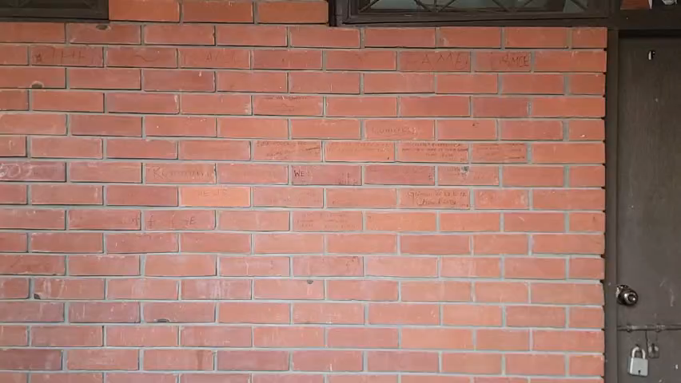

OUTPUT
INPUT VIDEO:
OUTPUT VIDEO:

Slide 8
OUTPUT
Output discussion:
>FrameMask is applied to each frame of the video one by one. The corresponding pixels from are set to white(255,255,255)
>However, in real life videos, there are various source of noises, which causes slight differences in pixel values from one frame to the next frame of the video.
>Therefore the background separation in our video is not perfect.

Slide 9
Output
Output discussion:
How to address this problem?
>By adjusting the mseThreshold value.
higher values will account for the noises in the video but too high value may cause improper detection of foreground object.
>By taking more frames at the beginning for training
>By applying Gaussian blur and/or Denoising to the input video before processing.

Slide 10
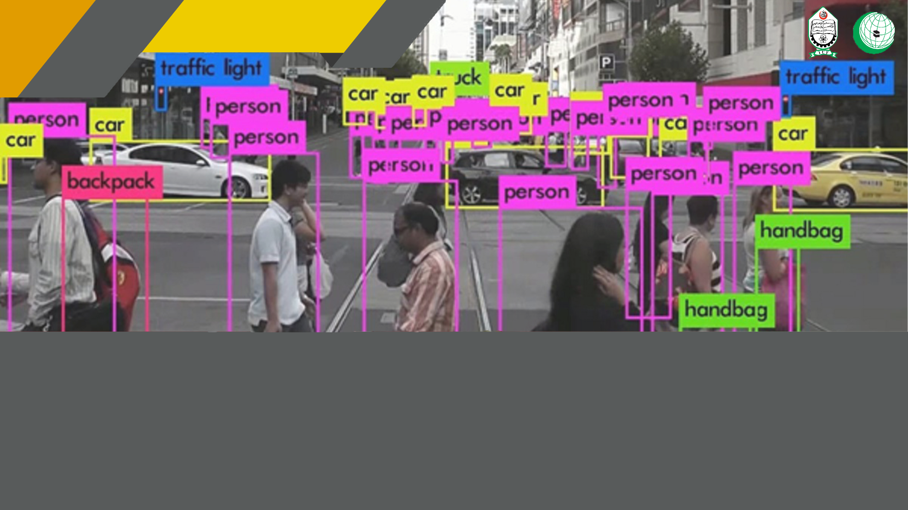
APPLICATION
a) Abnormal event detection
b) Person detection in dense crowds and people counting
c) Person tracking and identification
d) Fall detection for elderly people
e) Consumer Surveillance System:

Slide 11
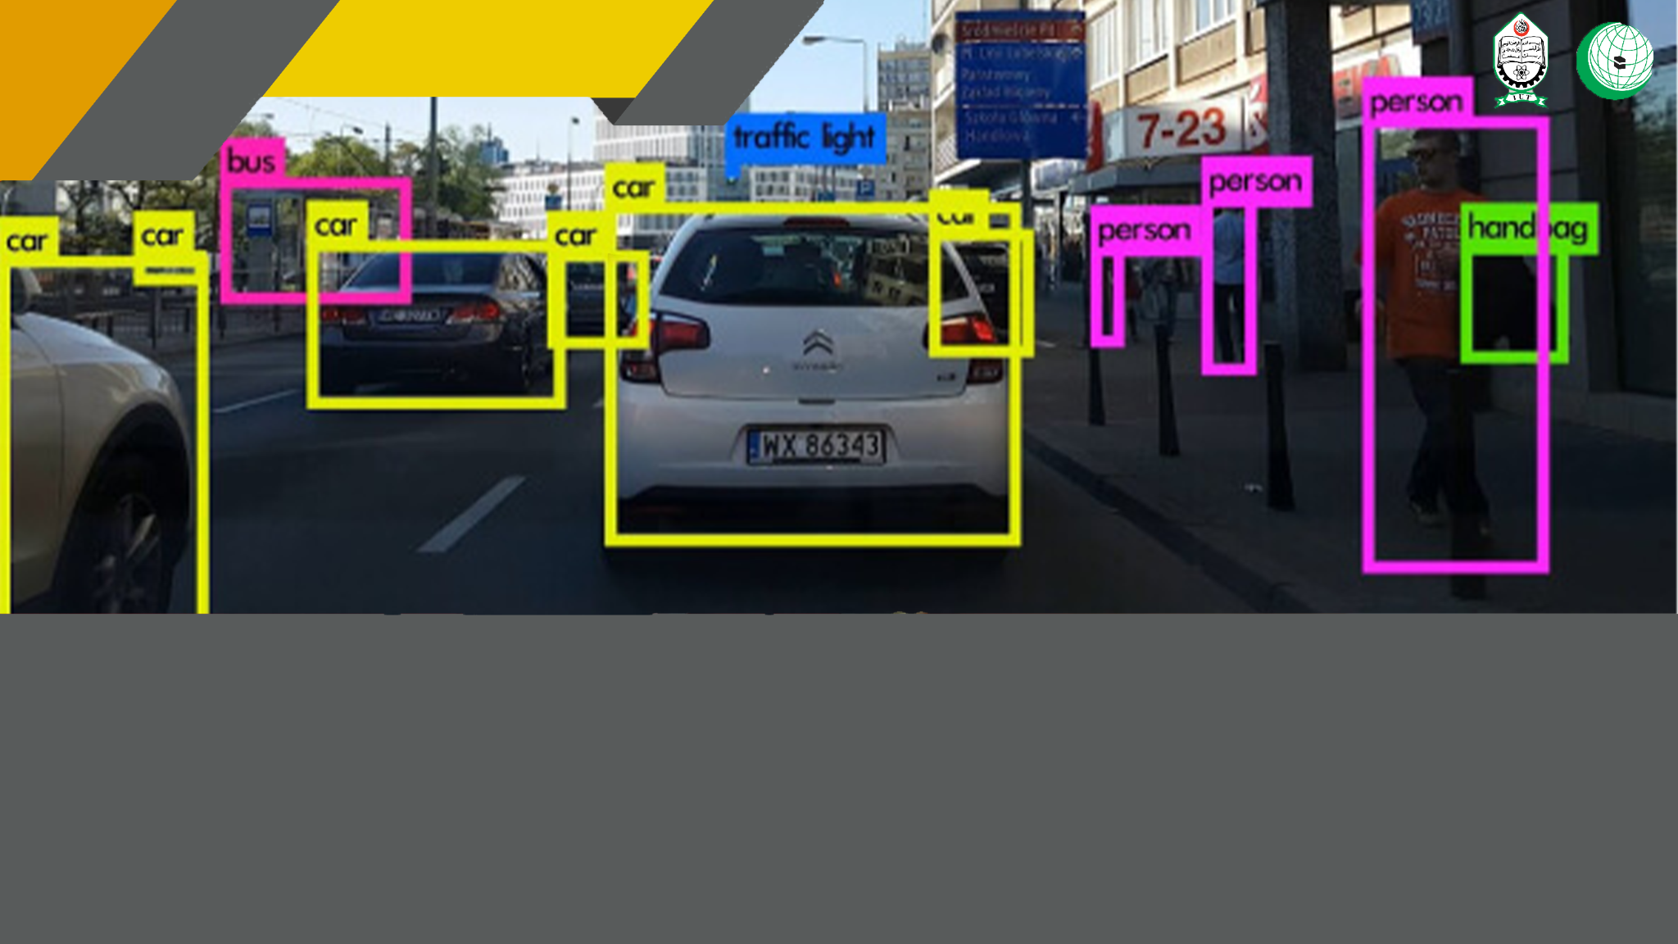
CONCLUSION
Overall Efficiency of the project is about 87.5%, i.e., most of cases gave the successful result by the proposed detection algorithm. The algorithm is robust to noise and can detect the human bodies under complex circumstance.

Slide 12
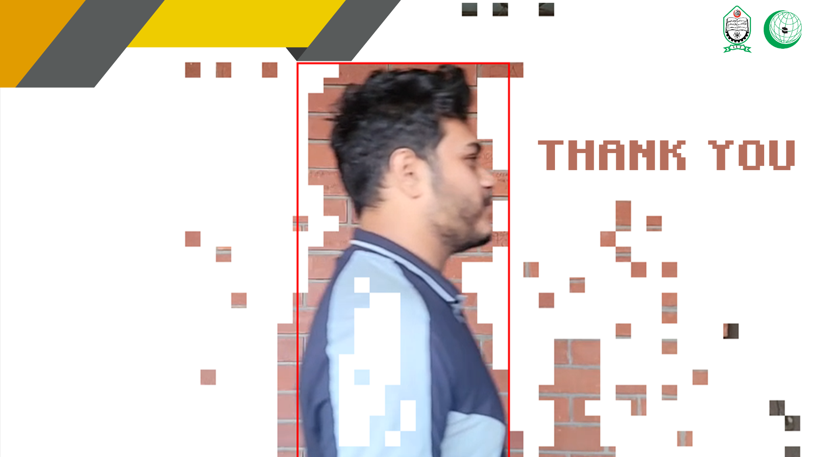
CONCLUSION

